Slide 1


Service Owner Guide - online feedback

Slide 2
What is online feedback?
This year, we are implementing a new way for students to submit academic feedback.
Our online feedback is a more streamlined and active approach to receiving and following up on feedback given by students.
This allows for direct communication between students and the SU, and the SU and University Staff. This applies to every piece of feedback.
The SU Team assigns each piece of feedback to a dedicated University Service Owner.
Digital Rep has been phased out and no longer exists as a brand.

Slide 3

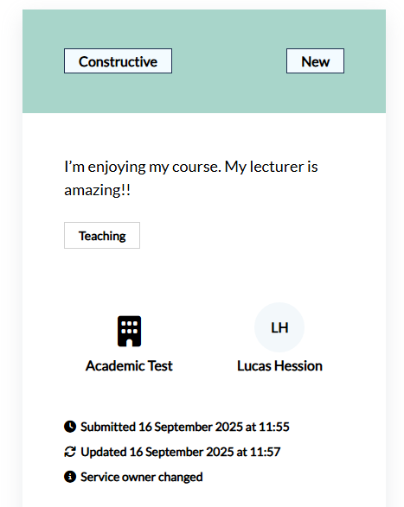
Service Owner Hub Layout
You can find your hub here.
Type of feedback: Constructive or Positive
Status of feedback
Student feedback
Tags, see notes for all tags
Area of feedback, usually the student’s programme and year
SU staff member assigned to the feedback item
Feedback created Last update Last update details
Notes:
Feedback Tags
Academic Support
Accessibility and Inclusivity
Assessment and Feedback
Communication
Course Content
Course Organisation
Dissertations or Projects
Exams
Learning Resources
Lectures
Other
Placements or Internships
Seminars or Tutorials
Teaching Quality
Timetabling
Workload

Slide 4
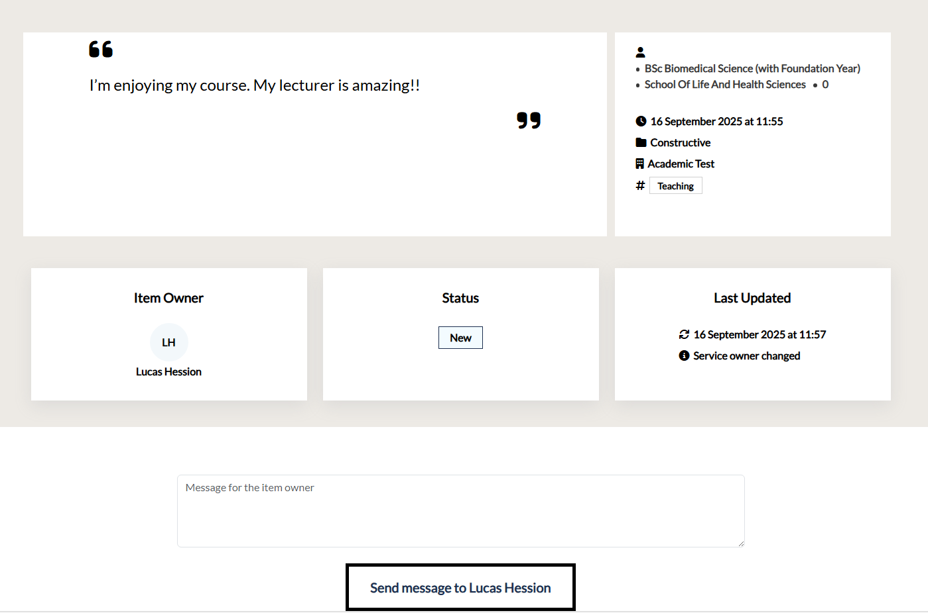
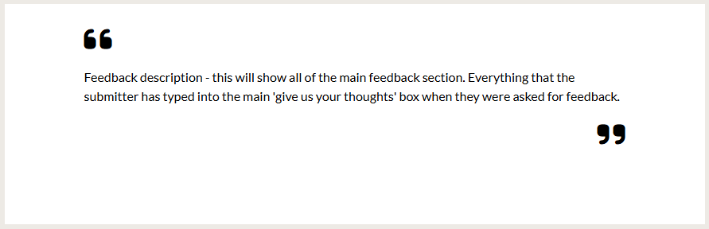

Individual Feedback Layout
You can find a test item here.
Programme, School and Year of student submitting feedback
Student feedback
Feedback created
Type of feedback
Area of feedback
Tags
SU staff member assigned to the feedback item
Last update details
Feedback status
Text box to communicate with the assigned SU staff member

Slide 5

How does it work?
When you are assigned a piece of feedback, it will appear as a card in your feedback hub. You will also receive an email notification to confirm this.
This card can be viewed, showing the full feedback item with a request from an SU staff member.
You should then share the feedback with a relevant colleague
This chatlog can be used to communicate between both parties to assure that the feedback loop is closed efficiently.
Each time a change is made on assigned feedback, the relevant party will receive an email to notify them.

Slide 6

Step by step
A piece of feedback is submitted via roehamptonsu.com/feedback
Once feedback is received, it is assigned to a university staff member.
This staff member will receive an email, notifying them of the assigned feedback and can now communicate with RSU staff through the chatlog.
The feedback is discussed, and all relevant actions are to be taken by university staff.
Once actions have been taken, if any, the university staff can communicate this in the chatlog, allowing RSU staff to close the feedback loop.

Slide 7
Making Student Life Better at Roehampton by Improving YOUR Academic Experience.

