Slide 1





Academic Representation Guide
2026/2027

Slide 2
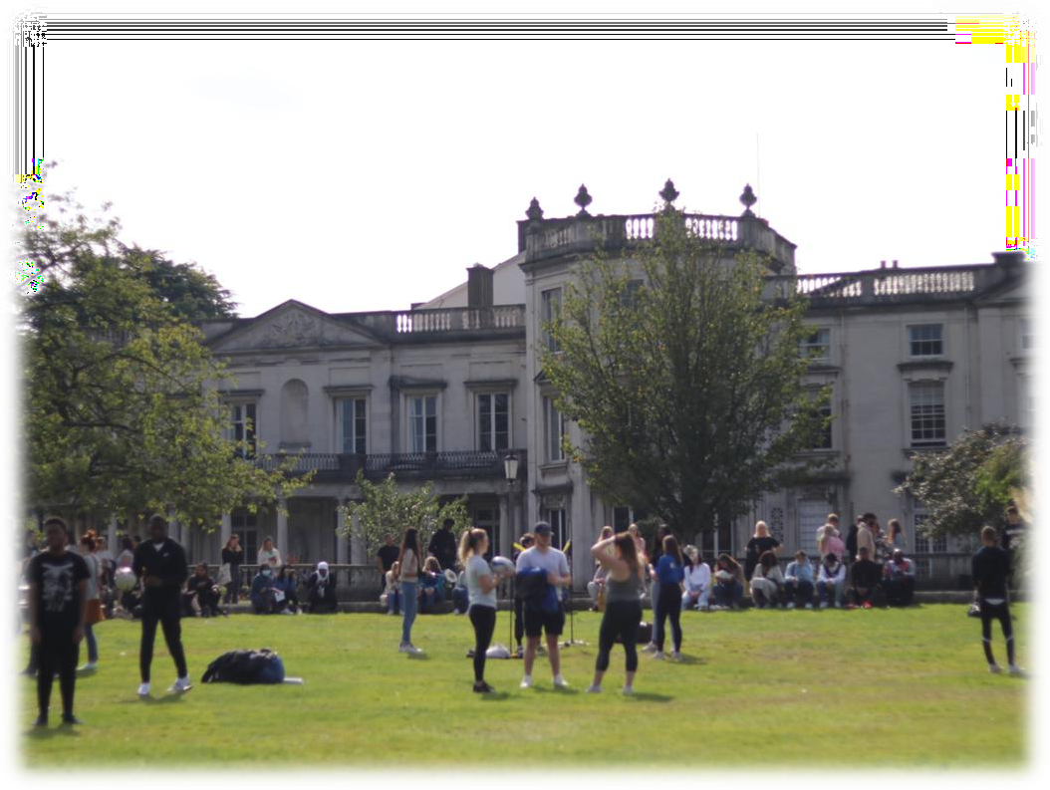
About The Students’ Union
Roehampton Students’ Union (RSU) is a student-led charity working in partnership with the University of Roehampton.
Our mission is to make student life better at Roehampton.
We’re led by elected officers who are supported by a professional career staff team.
We gather feedback, build community, run campaigns, and empower student representatives across campus.

Slide 3
Full-time Sabbatical Officers
Shane Lemos
President Education
Kshiteej Avinash Nimbalkar
President Community

Slide 4
Representation Team
Membership and Engagement Manager - Josh Miskin
Academic Communities Coordinator - Alabhya Tiwari
Campaigns and Insights Coordinator- Freddie Newell
Representation Assistants (current students)- Divanshi & Mariyam
General Enquiries - studentvoice@roehampton.ac.uk

Slide 5

Academic Representation
Listening to and amplifying student feedback.
Driving meaningful, positive change.
Working in partnership with academic and professional staff.

Slide 6
Academic Representation Roles
Role | Key Area | Core Responsibilities
Programme Reps | Programme | Gather feedback, attend Programme Boards, communicate with students and staff.
School Reps | School | Chair School Student Voice Forums (SSVF), lead School Networks, meet with Deans.
Vice President Education | University | Represents students at University Committees, runs campaigns, drives policy change.

Slide 7
Programme Reps
Voluntary • At least 2, per programme, per year
Represent academic interests at programme level.
Collect feedback from peers.
Use the SU’s feedback tool to log issues and ideas.
Attend Programme Boards, Student Voice Forums & RSU meetings.
Encourage survey engagement (Speak Week, NSS, etc.).
Share student feedback and meet with Programme Leads.

Slide 8
School Reps
Voluntary • 2 per school (UG & PG)
Represent student voice across their school.
Support and guide Programme Reps.
Chair the SSVF and help resolve feedback.
Promote Feedback and signpost staff/students.
Attend RSU forums, Student Senate & termly Dean meetings.
Act as a bridge between RSU, students, and the school.
Run School Networks.

Slide 9
Find Your School Rep
School of Psychology – Hanna Baxter (UG) & Vacant (PG)
School of Life and Health Sciences – Maria Owiny-Dollo (UG) & Vacant (PG)
School of Arts, Humanities & Social Sciences – Vacant (UG & PG)
School of Education – Maliha Siddique (PG) & Vacant (PG)
School of Continuing Education – Vacant (UG & PG)
Faculty of Business & Law:
-> School of Business – Biya Sharma (UG) & Vacant (PG)
-> School of Law – Dua Faisal (UG) & Vacant (PG)
School of Computing, Engineering and Built Environment – Niwhar Amin (UG) &
Vacant (PG)

Slide 10
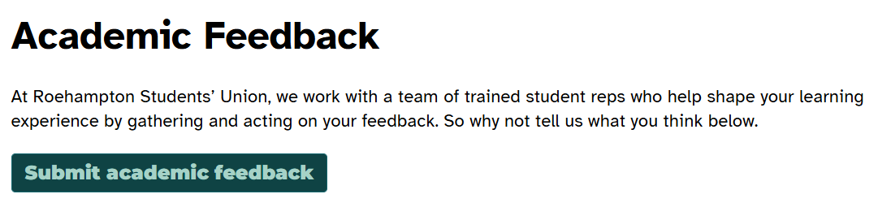
Feedback
The feedback form is available via the SU website.
Students can submit positive and constructive feedback 24/7.
Feedback is routed to the correct University contact.
Reps report on feedback in meetings.
SU staff can see open items, responses, and actions, making the feedback loop visible and actionable.

Slide 11
Your Role as Staff
You're a vital link between:
Students and their Reps.
The University and the SU.
You’ll help by:
Supporting Programme Reps and School Reps.
Collaborating with the SU for feedback meetings.
Maintaining communication with the SU.
Promoting feedback and Rep recruitment.
Ensuring student voice is integrated into decision-making.

Slide 12
Supporting Rep Recruitment
We need your help to recruit reps!
Promote sign-ups during induction.
Share recruitment links and posters.
Invite the SU to speak during welcome sessions. Register Programme Reps using this form.

Slide 13
Supporting Reps in their Roles
Encourage regular Rep-student check-ins.
Try not to be present during feedback collection sessions.
Share updates with reps when changes are made.
Give your reps 5 minutes during lectures to introduce themselves, collect feedback, and share results.

Slide 14

Communication & Resources
Schools receive regular updates from the SU:
Rep recruitment and vacancy updates for your school.
Key dates for upcoming Student Voice Forums (SSVF) and rep meetings.
Info on rep training, events, and system improvements.
Guidance on responding to feedback and engaging with reps.
Requests to approve rep-led actions or support meetings.
General SU news, campaigns, and rep recognition highlights.
Email Us
Academic Representation Webpage

Slide 15


Making student life better at Roehampton

